Slide 1
Customer Retention
By: Mayank Singh

Slide 2
Customer Retention?
Customer Retention means retaining first-time customers and preventing them from switching to a rival is known as customer retention. It shows how loyal customers are to a product or service as well as its quality.
Existing clients are the primary focus of customer retention.
Through superior customer service, product value, and a distinct advantage over similar products or services, the objective is to build customer loyalty and increase repeat purchases.
Retaining your customers is essential for generating repeat business and ongoing value.
Understanding your customers' satisfaction and loyalty are two of the most crucial aspects of improving customer retention.

Slide 3
How to retain customers?
Make sure the onboarding process is successful.
Provide individualized services to customers.
Establish trust with your clients.
Put in place a feedback loop for customers.
Create a calendar for communicating with customers.
Make customers the first priority.

Slide 4
Benefits of customer retention
Encourage long-term company expansion.
Make each sale worth more to each customer.
Increase referrals and customer loyalty while lowering your acquisition costs by better understanding your customers' motivations.
Develop better products, faster.
Experiment safely with customers who are open to change.

Slide 5
customer retention rate
(Total customers at end of period – new customers acquired) / Customers at beginning of period * 100

Slide 6
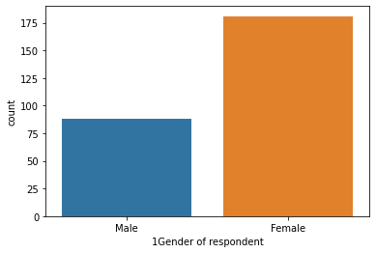
Data analysis females customers are more in comparison to men

Slide 7
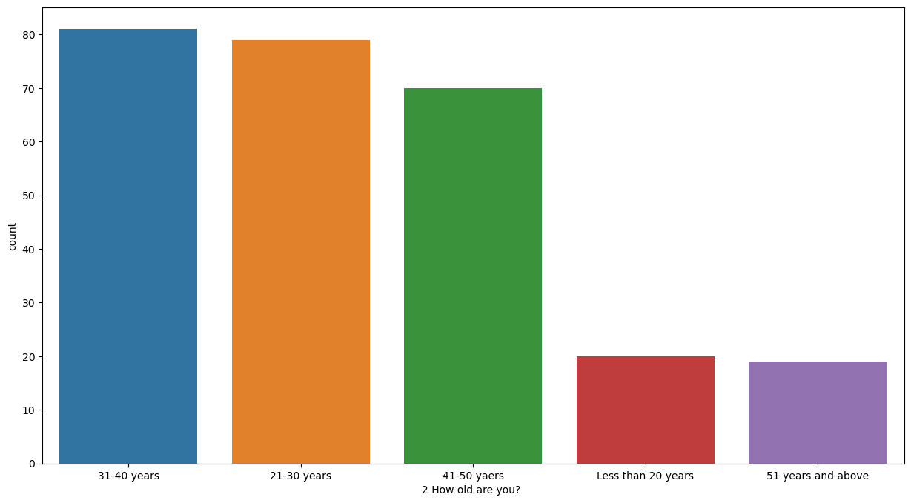
People aged 31-40 years are potential customers

Slide 8
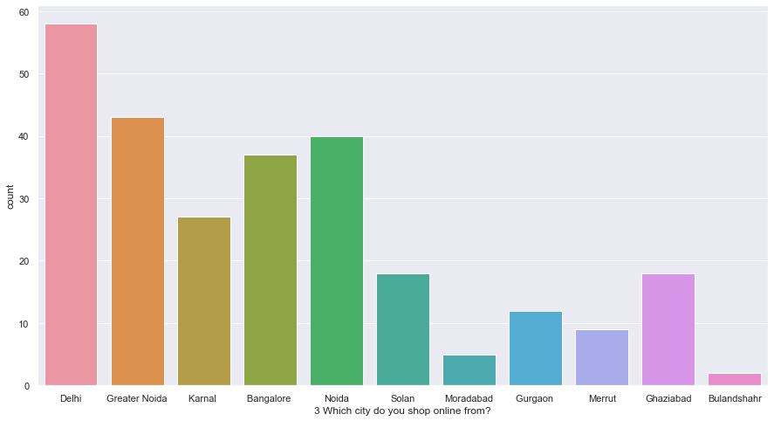
Delhi has the highest number of customers.

Slide 9
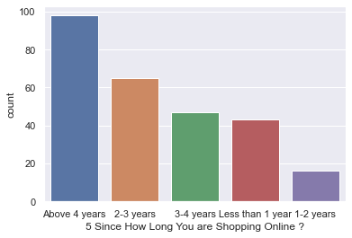
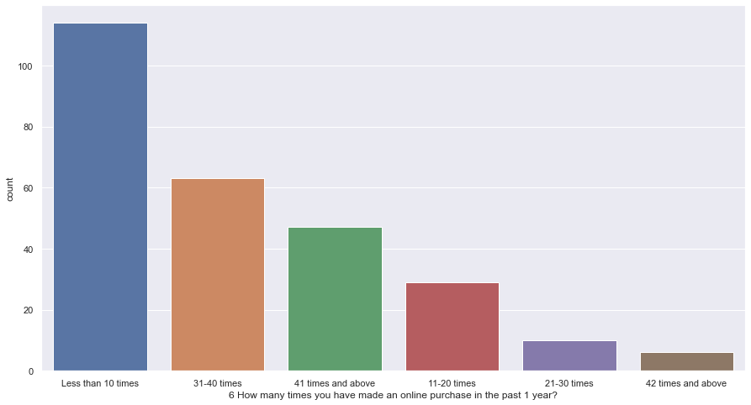
People are shopping above 4 years and has made an online purchase less than 10 times.

Slide 10
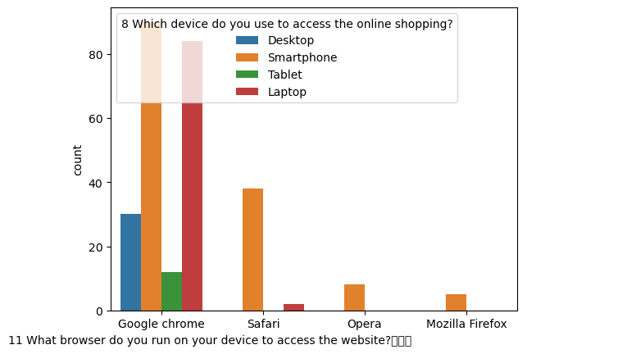
How they do shopping?

Slide 11
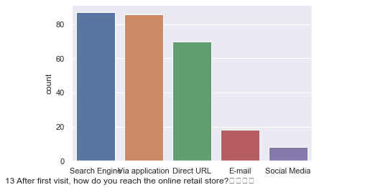
How customer reached to online website?

Slide 12
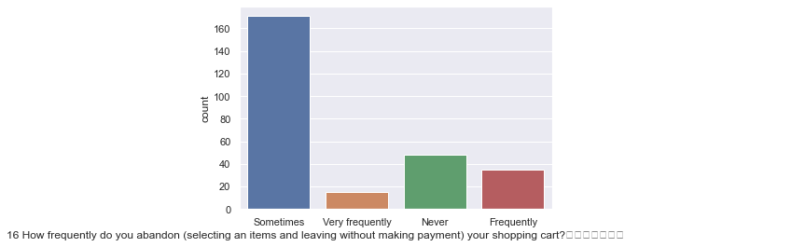
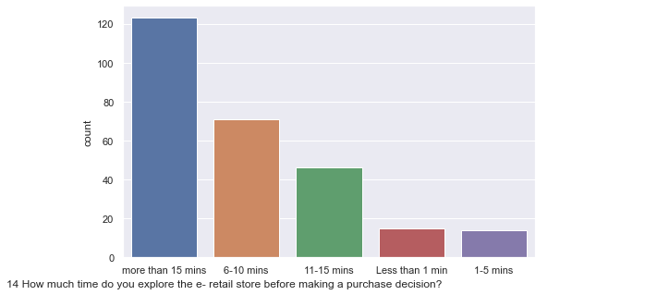
Customer habits like time they spend and abandon the cart.

Slide 13
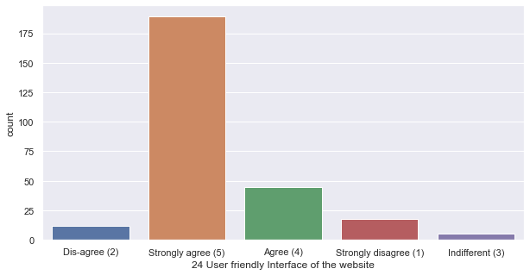
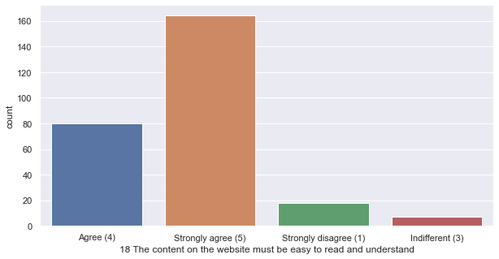
About Website

Slide 14
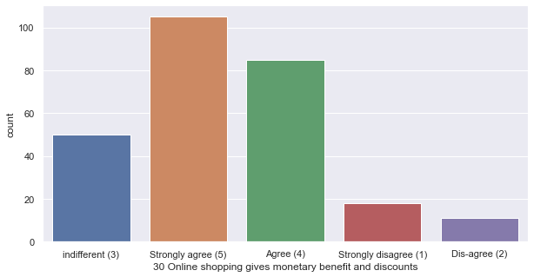
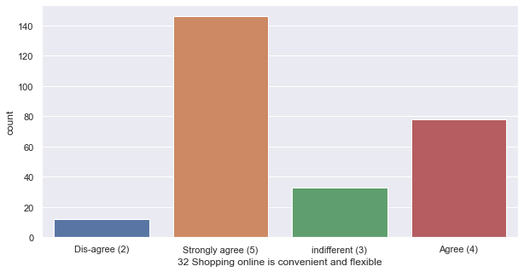
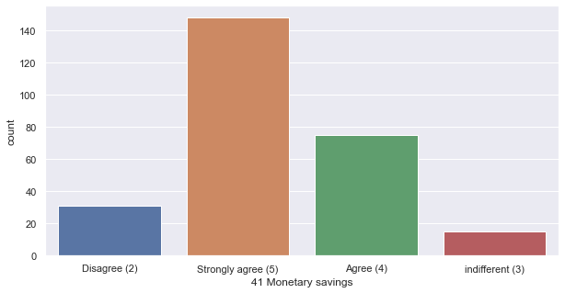
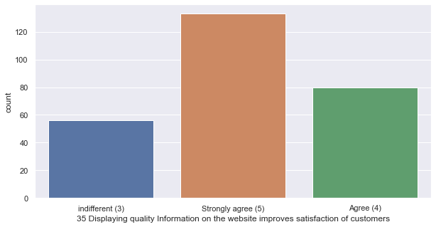
.

Slide 15
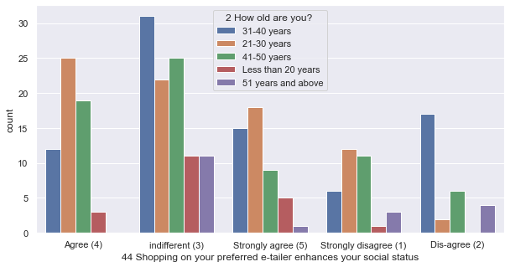
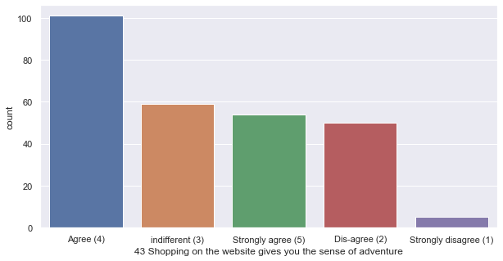
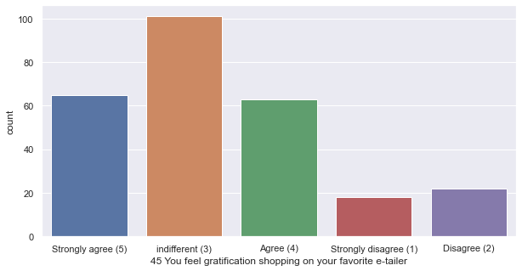
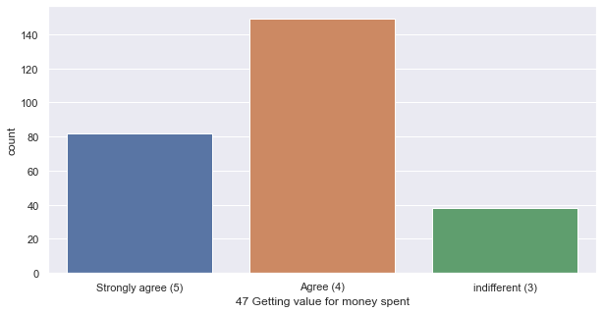
Hedonic values

Slide 16
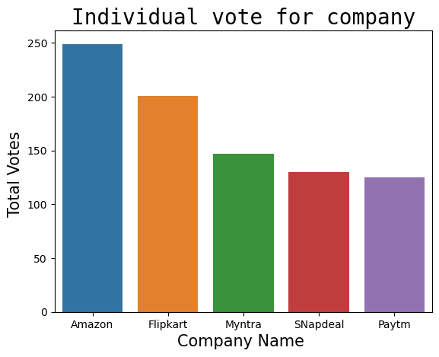
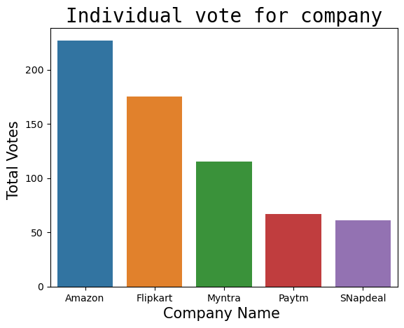
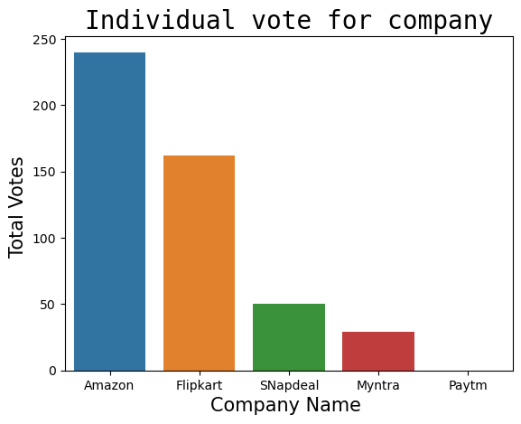
Which company is preferred the most?
Visual appealing web-page layout choices
Easy to use website

Slide 17
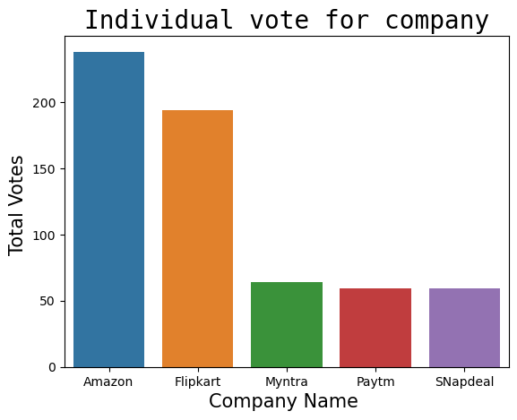
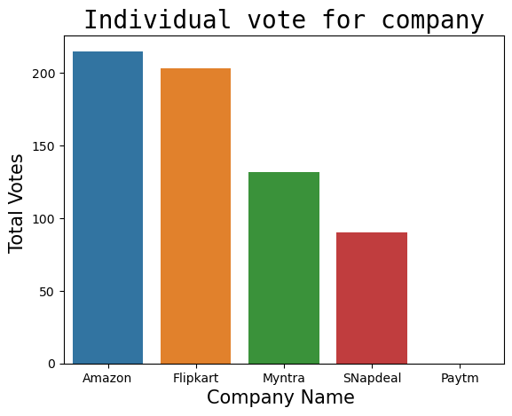
Which company has high product availability?
Wild Variety of Product
Complete, relevant description information of products
several payment options

Slide 18
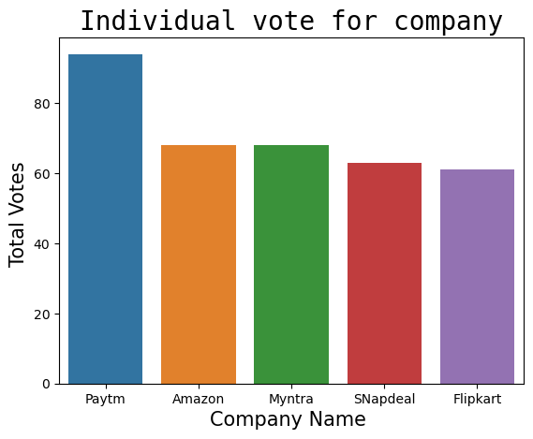
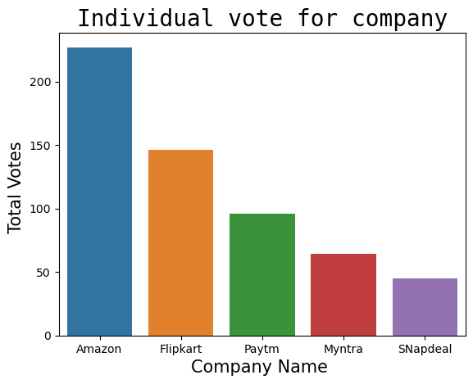
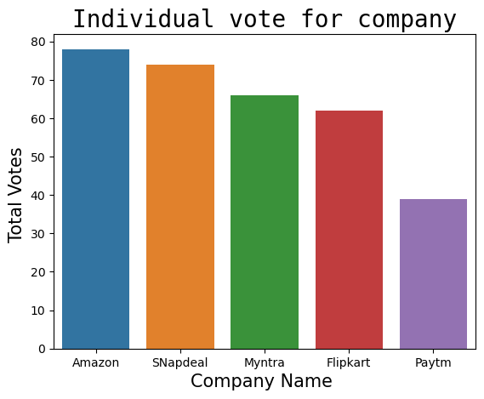
Technical performance
Longer page loading time
Reliability of the website
Frequent disruption on page change

Slide 19
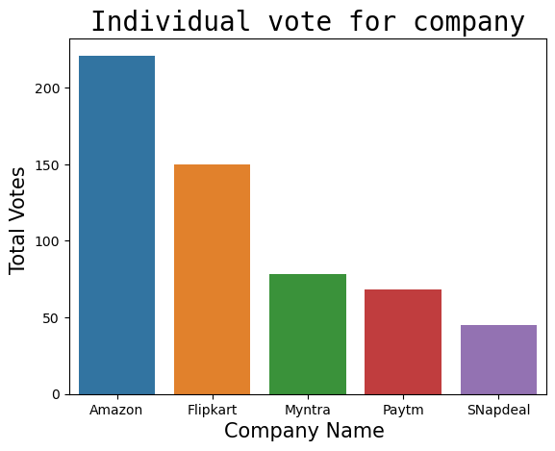
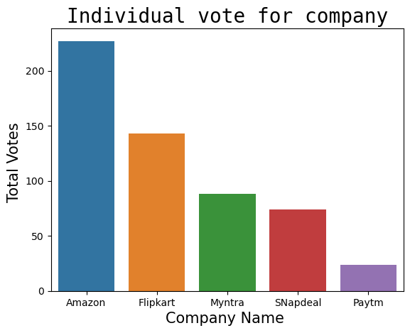
Privacy of customer.
Privacy of customer information
Security of customer financial information
Trustworthiness

Slide 20
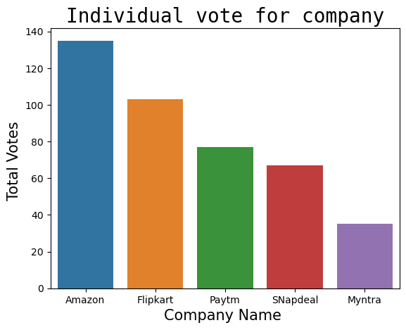
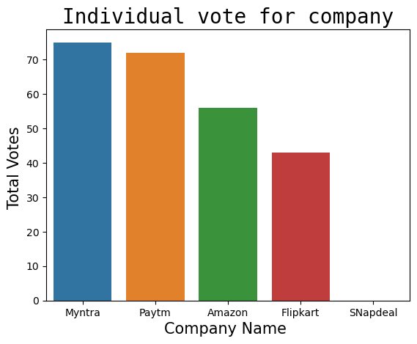
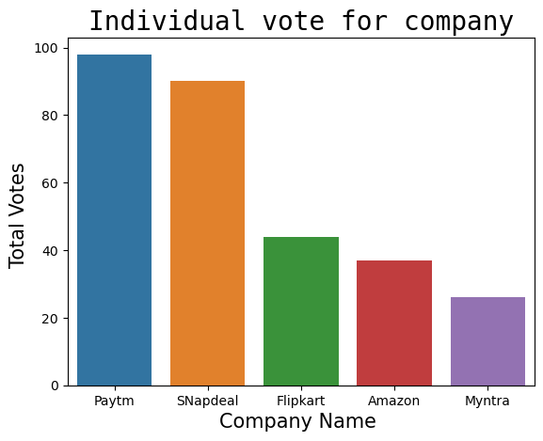
Performance during sales
Longer time to get logged in
Late declaration of price
Longer Delivery period

Slide 21
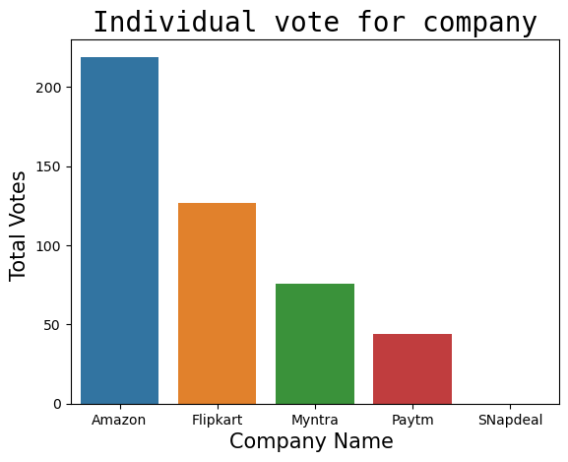
Which of the Indian online retailer would you recommend to a friend?
Amazon is the most recommended one.

Slide 22

After encoding, correlation defined
Correlation means two variables are linearly related.

